Slide 1
Modern Data Architectures
Cloud Databases

Slide 2
Cloud Models

Slide 3
Cloud Models - Objective Domain
Define cloud computing
Describe Public cloud
Describe Private cloud
Describe Hybrid cloud
Compare and contrast the three different cloud models

Slide 4









What is cloud computing?

Slide 5
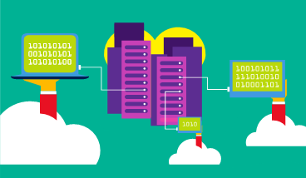
Public cloud
Owned by cloud services or hosting provider.
Provides resources and services to multiple organizations and users.
Accessed via secure network connection (typically over the internet).

Slide 6
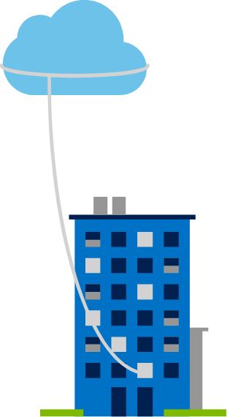
Private cloud
Organizations create a cloud environment in their datacenter.
Organization is responsible for operating the services they provide.
Does not provide access to users
outside of the organization.
Example: VIC (Virtual IT Company) HOGENT

Slide 7
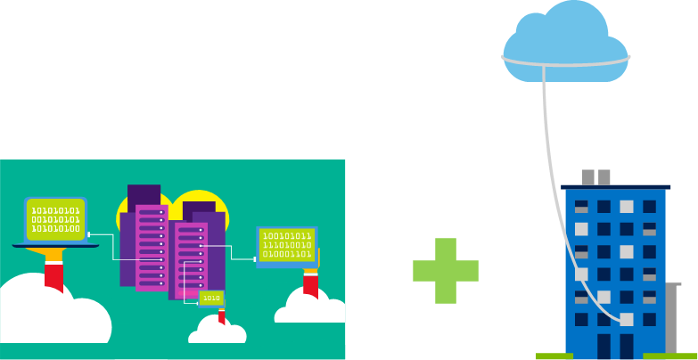
Hybrid cloud
Combines Public and Private clouds to allow applications to run in the most appropriate location.

Slide 8
Cloud model comparison
No capital expenditures to scale up.
Applications can be quickly provisioned and deprovisioned.
Organizations pay only for what they use.
Public Cloud
Hardware must be purchased for start-up and maintenance.
Organizations have complete control over resources and security.
Organizations are responsible for hardware maintenance and updates.
Private Cloud
Provides the most flexibility.
Organizations determine where to run their applications.
Organizations control security, compliance, or legal requirements.
Hybrid Cloud

Slide 9
Cloud benefits and considerations

Slide 10
Cloud Benefits - Objective Domain
Identify the benefits of cloud computing such as High Availability, Scalability, Elasticity, Agility, and Disaster Recovery.
Identify the differences between Capital Expenditure (CapEx) and Operational Expenditure (OpEx).
Describe the consumption-based model.

Slide 11







Cloud Benefits

Slide 12

Compare CapEx vs. OpEx
Capital Expenditure (CapEx)
The up-front spending of money on physical infrastructure.
Costs from CapEx have a value that reduces over time.
Operational Expenditure (OpEx)
The spending and billing of services or products as needed.
Expenses are deducted in the same year.

Slide 13
Consumption-based model
Cloud service providers operate on a consumption-based model, which means that end users only pay for the resources that they use. Whatever they use is what they pay for.
Better cost prediction
Prices for individual resources and services are provided
Billing is based on actual usage

Slide 14
Cloud services

Slide 15
Cloud Services - Objective Domain
Describe Infrastructure-as-a-Service (IaaS)
Describe Platform-as-a-Service (PaaS)
Describe Software-as-a-Service (SaaS)
Identify a service type based on a use case
Describe the shared responsibility model
Describe serverless computing

Slide 16
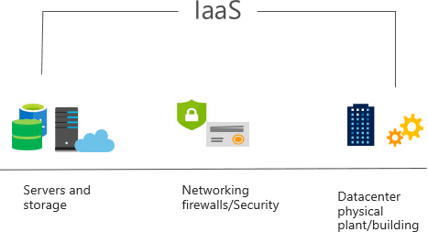
Infrastructure as a Service (IaaS)
Build pay-as-you-go IT infrastructure by renting servers, virtual machines, storage, networks, and operating systems from a cloud provider.

Slide 17
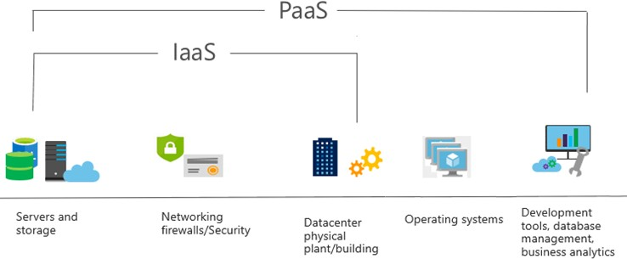
Platform as a Service (PaaS)
Provides environment for building, testing, and deploying software applications; without focusing on managing underlying infrastructure.

Slide 18
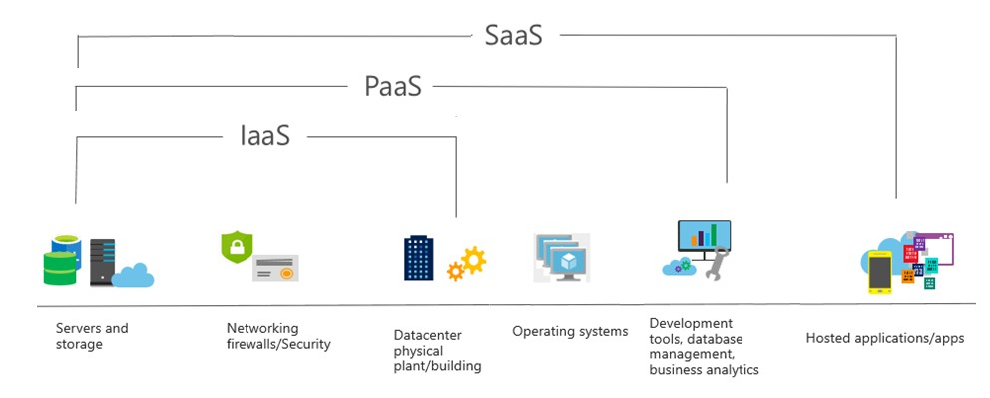
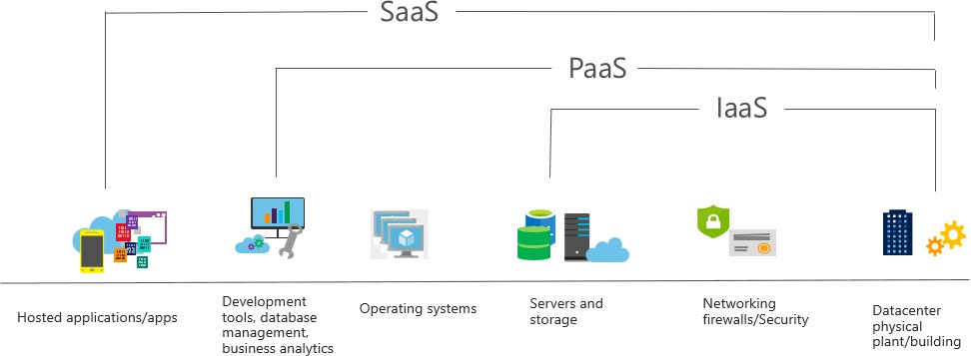
Software as a Service (SaaS)
Users connect to and use cloud-based apps over the internet: for example, Microsoft
Office 365, email, and calendars.

Slide 19
Cloud service comparison
IaaS
PaaS
SaaS
The most flexible cloud service.
You configure and manage the hardware for your application.
Focus on application development.
Platform management is handled by the cloud provider.
Pay-as-you-go pricing model.
Users pay for the software they use on a subscription model.

Slide 20






Shared responsibility model

Slide 21
Cloud Databases

Slide 22
What is a cloud database?
Provided by the public or private cloud provider as fully managed software solution
The data is also managed on cloud storage.
Data is stored in a cloud storage tier (such as a cloud object store, distributed datastore or other proprietary cloud storage infrastructure).
These systems are designed to support applications that go from transactional and/or analytical processing to data warehouses and deep learning.

Slide 23
Commericial Cloud (Database) Providers
Microsoft Azure
Amazon AWS
Alibaba
IBM
Google Cloud
Oracle Cloud Architecture (OCI)
Snowflake cloud database

Slide 24
Data on Microsoft Azure

Slide 25


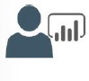
Roles in Data
Database Administrator Database Management Implements Data Security Backups
User Access
Monitors performance
Data Engineer
Data Pipelines and processes Data Ingestion storage Prepare data for Analytics
Prepare data for analytical processing
Data Analyst
Provides insights into the data Visual Reporting
Modeling Data for Analysis
Combines data for visualization and analysis

Slide 26
Common Tools – Database Administrator
Azure Data Studio
Graphical interface for managing on-premises and cloud-based data services
Runs on Windows, macOS, Linux
SQL Server Management Studio
Graphical interface for managing on-premises and cloud-based data services
Runs on Windows
Comprehensive Database Administration tool
Azure Portal / CLI
Tools for management and provisioning of Azure Data Services
Manual and automation of scripts using Azure Resource Manager or Command Line Interface scripting

Slide 27
Common Tools – Data Engineering
Azure Synapse Studio
Azure Portal integrated to manage Azure Synapse
Data Ingestion (Azure Data Factory)
Management of Azure Synapse assets (SQL Pools / Spark Pool)
SQL Server Management Studio
Graphical interface for managing on-premises and cloud-based data services
Runs on Windows
Comprehensive Database Administration tool
Azure Portal / CLI
Tools for management and provisioning of Azure resources
Manual and automation of scripts using Azure Resource Manager or Command Line Interface scripting

Slide 28
Common Tools – Data Analyst
Power BI Desktop
Data Visualization tool
Model and Visualize Data
Management of Azure Synapse assets (SQL Pools / Spark Pool)
Power BI Portal / Power BI Service
Authoring and management of Power BI reports
Authoring of Power BI dashboards
Share Reports / Datasets
Power BI Report Builder
Data Visualization tool for paginated reports
Model and Visualize paginated reports

Slide 29
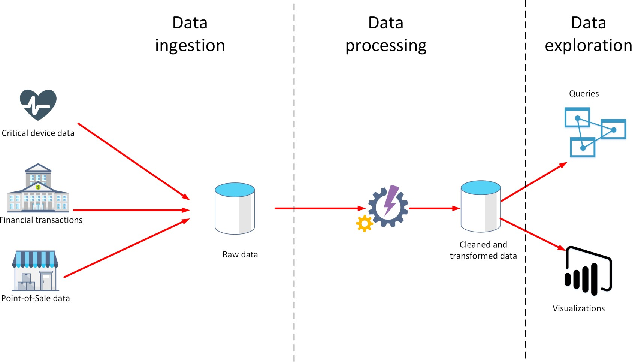
What is data ingestion?

Slide 30
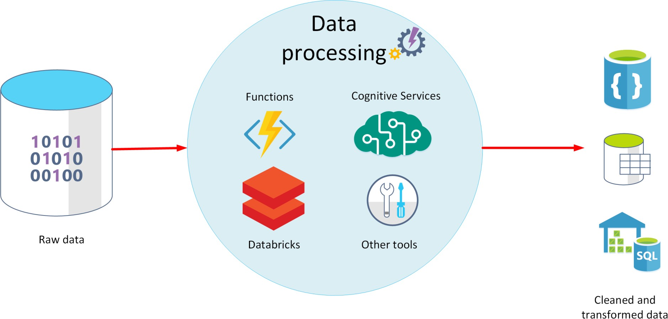
What is data processing?

Slide 31
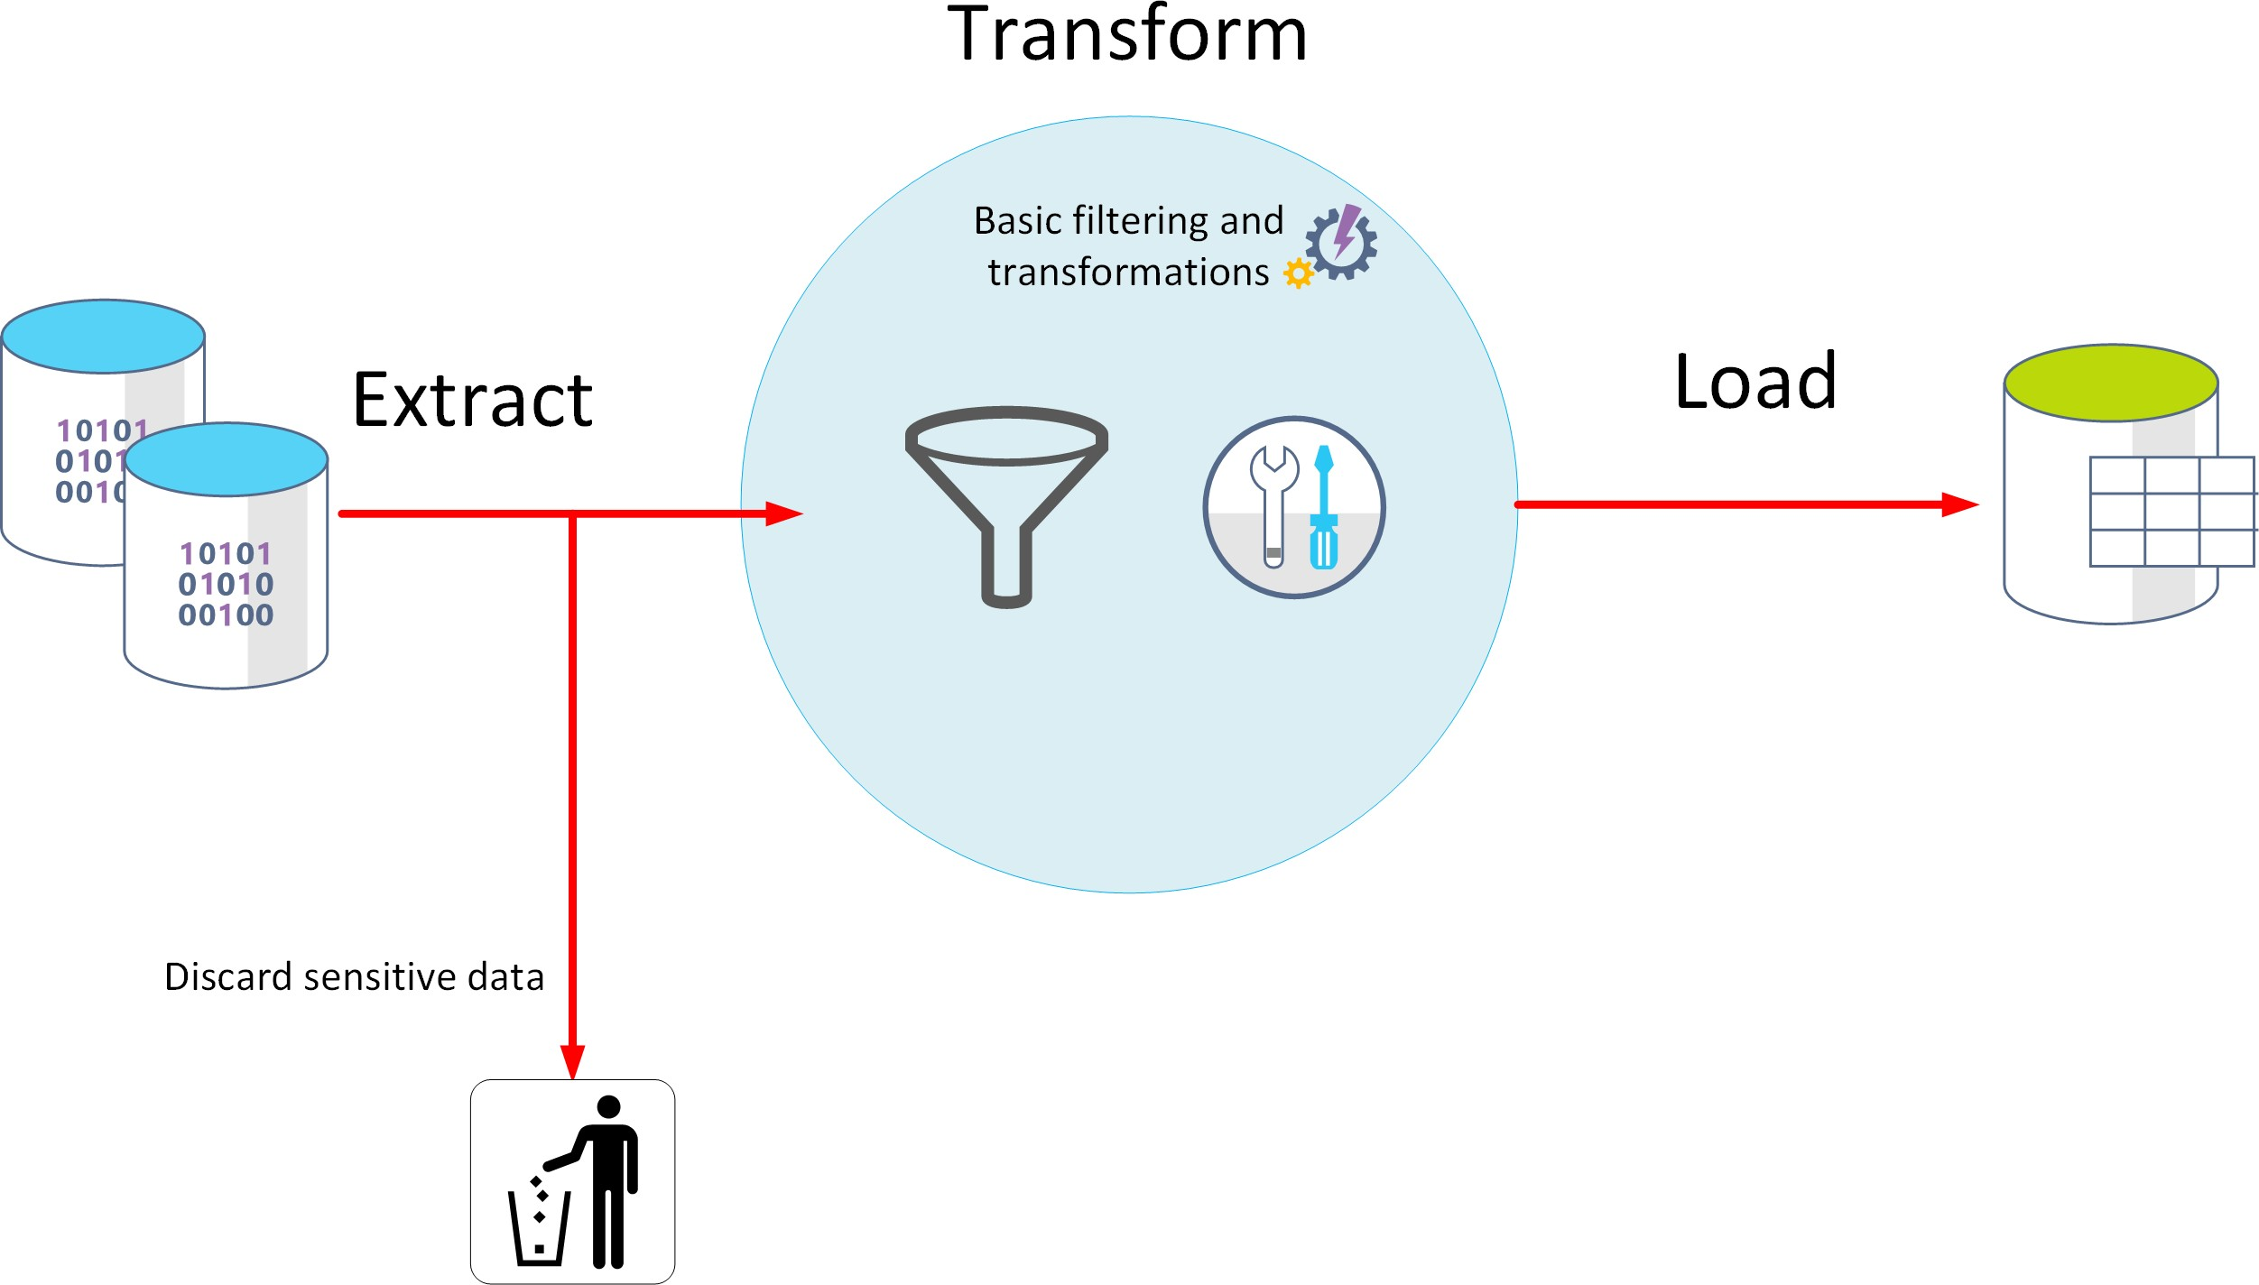
What is ETL?

Slide 32
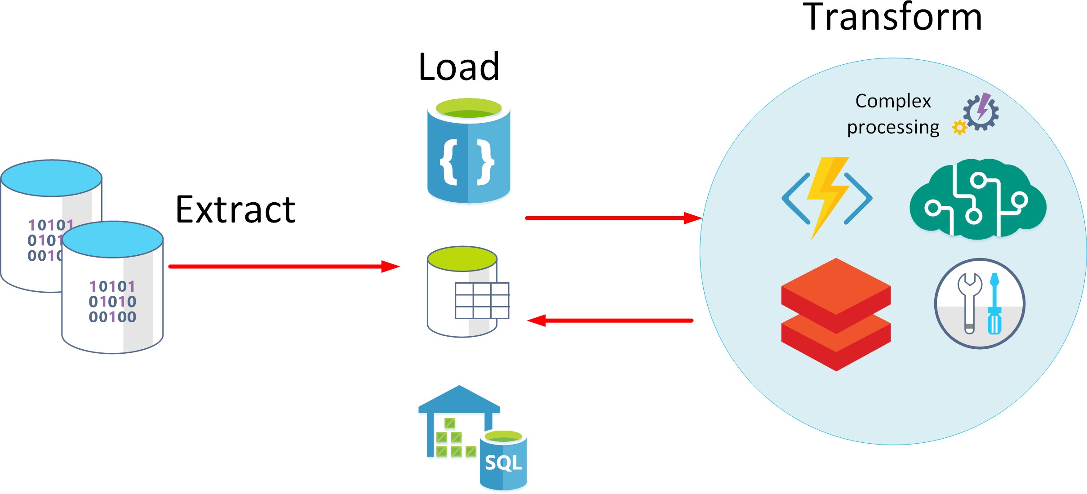
What is ELT?
Datalake

Slide 33
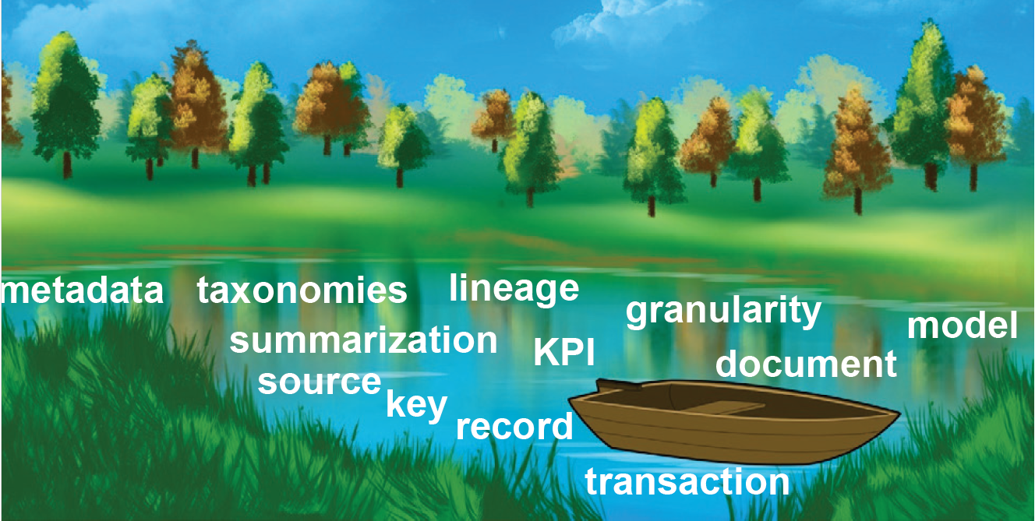
Datalake
A repository of raw data.
Data was simply placed into the data lake for anyone to analyze or use.
The data lake data comes from a wide variety of sources.
Currently, an analytical infrastructure is built from the raw data:
Identify how data related to each other
Identify the timeliness of data
Examine the quality of the data
Identify the lineage (NL: herkomst, afstamming) of data

Slide 34
ELT
Extract Load Transform, alternative to ELT, mostly used in the cloud.
Data is only transformed to the required format when analytics is needed.
Use case:
You have data about money from the US, Australia, and Canada. All three currencies are in dollars.
In a classic DWH setup (with ETL) you would probable convert all data about money to a single currency, so you can easily add them together when making reports.
But you can’t just add the dollars together and have a meaningful answer. Instead, to have a meaningful answer, you have to convert (transform) two of the three currencies to a common value. Then, and only then, can you add the values up in a meaningful manner. And even then, the truthfulness of the data is only relevant to the moment that data has been recalculated because exchange rates fluctuate on a daily/hourly basis.

Slide 35
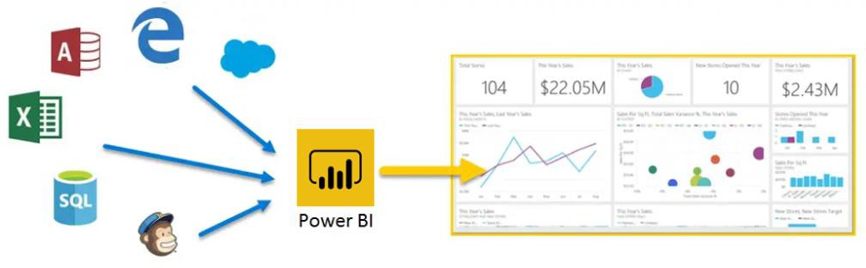
Explore Data Visualization
Power BI: A collection of software, services, apps, and connectors.

Slide 36







Explore Data Analytics
Descriptive
Diagnostic
Predictive
Prescriptive
Cognitive

Slide 37
Relational Data Offerings in Microsoft Azure

Slide 38
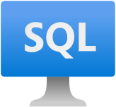
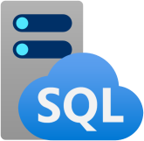
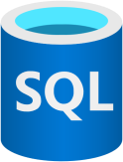
What are Azure Data Services?
SQL Server on Azure
Virtual Machines
Azure SQL Managed Instance
Azure SQL Database
Best for re-hosting and apps requiring OS-level access and control
Automated manageability features and OS-level access
Best for modernizing existing apps
Best for building new apps in the cloud
Pre-provisioned or serverless compute and Hyperscale storage to meet demanding workload requirements
Offers high compatibility with SQL Server and native VNET support
Infrastructure as a Service
Platform as a Service

Slide 39

SQL Server on Azure virtual machines
Key features
SQL Server and OS server access Expansive SQL and OS versions Windows, Linux, Containers
File stream, DTC, and Simple Recovery
model
SSAS, SSRS, and SSIS
Azure differentiators
Free Extended Security Updates for SQL Server 2008/R2
Automated Backups and Security Updates
Point in Time Restore with Azure Backup
Accelerated storage performance with Azure Blob Caching
435 percent overall return on an Azure IaaS investment over five years¹
Customer challenge
I want to migrate to the cloud as fast as possible but maintain operating system control and complete SQL Server functionality
Solution
Get the combined performance, security, and analytics of SQL Server, backed by the flexibility, security, and hybrid connectivity of Azure

Slide 40
Azure SQL DB
Key features
Single database or elastic pool Hyperscale storage (100TB+) Serverless compute
Fully managed service
Private link support
High availability with AZ isolation
Azure differentiators
Industry highest availability SLA of 99.995%
Industry only business continuity SLA with 5 second RPO and 30 second RTO
Price-performance leader for mission- critical workloads while costing up to 86 percent less than AWS RDS (GigaOm)
Customer challenge
I want to build modern apps, potentially multi- tenanted, with the highest uptime and predictable performance
Solution
Azure SQL Database is a highly scalable cloud database service with built-in high availability and machine learning
Multi-tenant = multi-customers (≠users) each working in their own environment.

Slide 41
Azure SQL DB Service Tiers
General purpose
Business critical
Hyperscale*
Most business workloads
Workloads that require low latency, fast recovery, and a readable secondary
Most business workloads with highly scalable storage and read- scale requirements
Remote storage IOPS
$ Serverless*
P
Local storage IOPS++
$$$
In-memory
P S S R
Local + remote storage IOPS+
$$ Unlimited storage
P R R R R
*Not in managed instance

Slide 42
Azure SQL DB Managed Instance
Key features
Single instance or instance pool
SQL Server surface area (vast majority) Native virtual network support
Fully managed service
On-premise identities enabled with Azure AD and AD Connect
Azure differentiators
Near zero downtime migration using log shipping
Fully managed business continuity with failover groups
Projected return on investment of 212 percent over three years¹
The best of SQL Server with the benefits of a managed service
Customer challenge
I want to migrate to the cloud, remove management overhead, but I need instance-scoped features (Service Broker, SQL Server Agent, CLR…)
Solution
Managed instance combines leading security features with SQL Server compatibility and business model designed for on-premises customers

Slide 43
Managed Instance Service Tiers
General purpose
Business critical
Most business workloads
Workloads that require low latency, fast recovery, and a readable secondary
vCore model
Independent scalability
Remote storage IOPS
$
Local storage IOPS++
$$$
In-memory

Slide 44
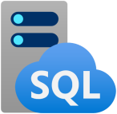
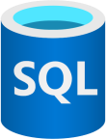
Azure SQL Managed instance or DB
Azure SQL managed
instance
Azure SQL Database
Single instance
SQL Server surface area (vast majority)
Native virtual network support
Fully managed service
Instance pool
Pre-provision compute resources for migration
Enables cost-efficient migration.
Ability to host smaller instances (2Vcore)
Currently in public preview
Single database
Hyperscale storage (up to 100TB)
Serverless compute Fully managed service
Elastic pool
Resource sharing between multiple databases to price optimize
Simplified performance management for multiple databases
Fully managed service

Slide 45


PostgreSQL, MariaDB, MySQL
PostgreSQL is the most popular and wanted database for modern apps
MySQL is a leading open source relational database for LAMP stack apps
MariaDB is a community-developed fork of MySQL with strong focus on the user community

Slide 46

Benefits of Azure Database for MySQL, PostgreSQL, MariaDB
Fully managed community database
Built-in high availability for lowest TCO
Intelligent performance and scale
Industry-leading
security and compliance
Integration with the
Azure ecosystem
Take advantage of a fully managed service while still using the tools and languages you're familiar with
Ensure your data is always available without the need for additional costs
Improve performance with built-in intelligence and up to 16TB storage and 20K IOPs
Protect your data with enhanced security features including Advanced Threat Protection
Build apps faster with Azure services and safeguard your innovation with Azure IP Advantage

Slide 47
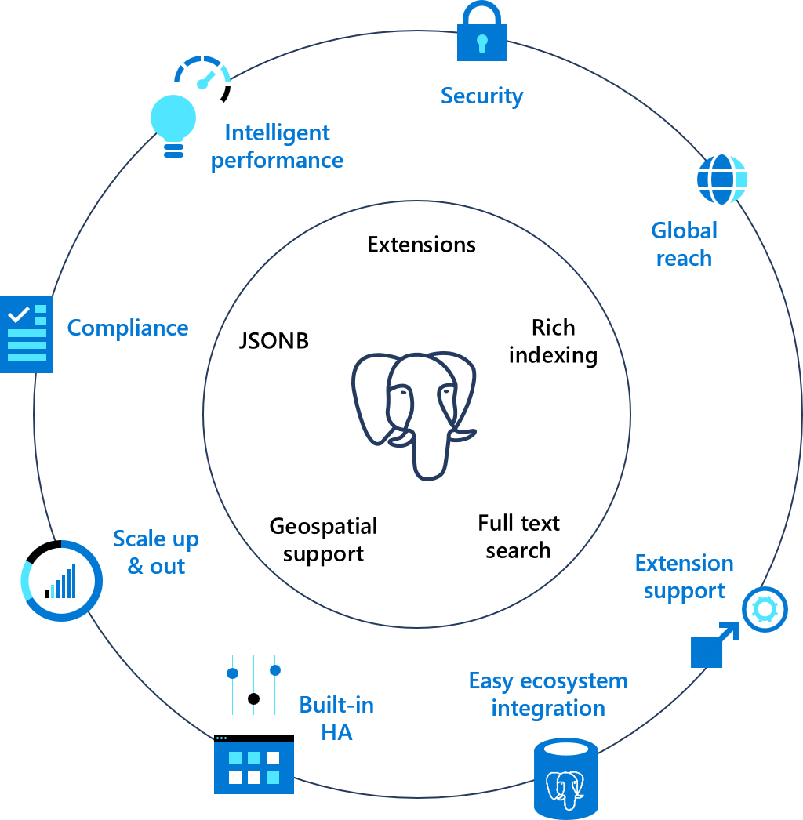
Azure Database for PostgreSQL
Azure builds upon the core benefits of PostgreSQL and Open Source
Azure Database for PostgreSQL is
fully-managed, community PostgreSQL

Slide 48






The benefits of Azure Database for PostgreSQL
Build or migrate your workloads with confidence and optimized for value
Fully managed and
secure
Intelligent performance
optimization
Flexible and open
High performance scale-out with Hyperscale
Single Server
Hyperscale

Slide 49
Non-relational Data Offerings in Microsoft Azure

Slide 50
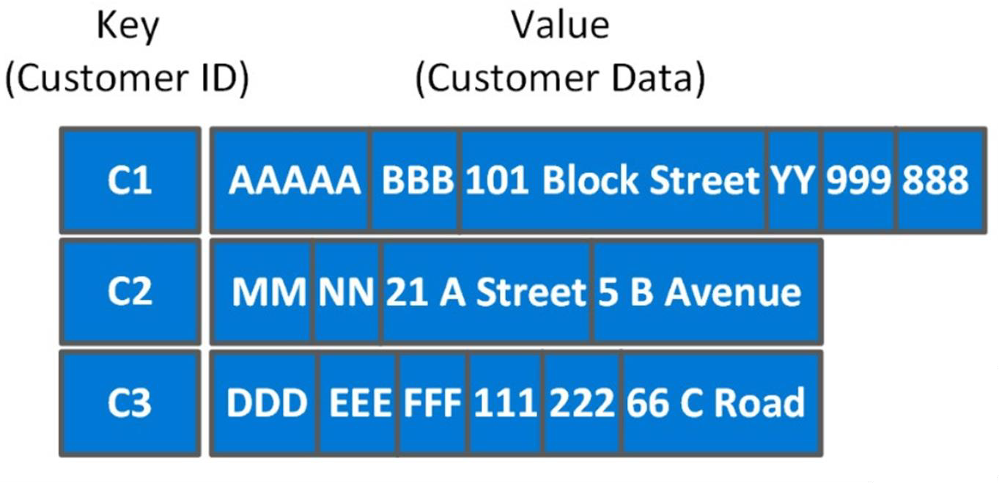
Explore Azure Table storage

Slide 51
Explore Azure Blob Storage
Block blobs
Has a maximum size of 4.7TB Best for storing large, discrete, binary objects that changes infrequently Each individual block can store up to 100MB of data A block blob can contain up to 50000 blocks
Page blobs
Can hold up to 8TB of data Is organized as a collection of fixed sized-512 byte pages Used to implement virtual disk storage for virtual machines
Append blobs
The maximum size is just over 195GB Is a block blob that is used to optimize append operations Each individual block can store up to 4MB of data

Slide 52
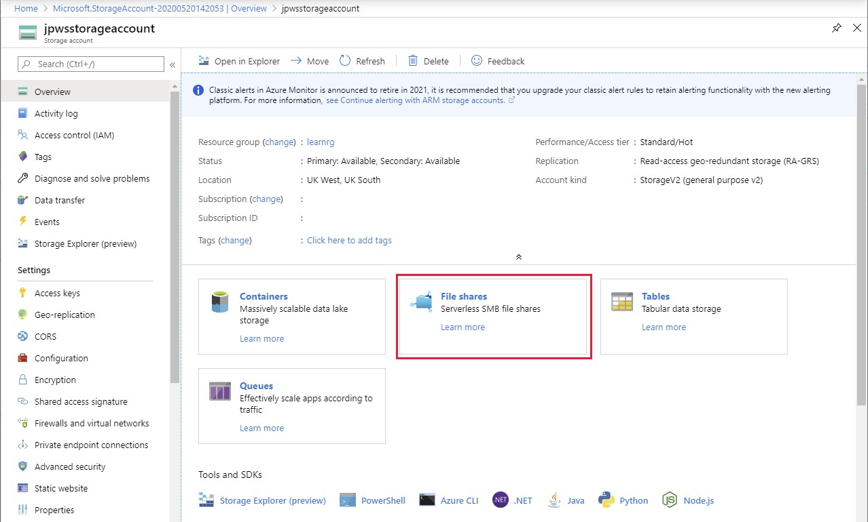
Explore Azure File Storage

Slide 53

Explore Azure Cosmos DB
Scalability
Performance
Availability
Programming model

Slide 54
Use cases for Azure Cosmos DB
Web and retail
Using Azure Cosmos DB's multi-master replication model along with Microsoft's performance commitments, Data Engineers can implement a data architecture to support web and mobile applications that achieve less than a 10-ms response time anywhere in the world
Gaming
The database tier is a crucial component of gaming applications. Modern games perform graphical processing on mobile/console clients but rely on the cloud to deliver customized and personalized content like in-game stats, social media integration, and high-score leader boards.
IoT scenarios
Hundreds of thousands of devices have been designed and sold to generate sensor
data known as Internet of Things (IoT) devices. Using technologies like Azure IoT Hub,
Data Engineers can easily design a data solution architecture that captures real-time data. Cosmos DB can accept and store this information very quickly

Slide 55
Snowflake
De facto standard in world of cloud scale datawarehouses.
Dataplatform and datawarehouse that supports SQL.
Can work cross-cloud.

